Slide 1

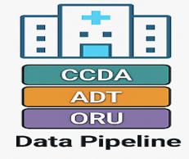
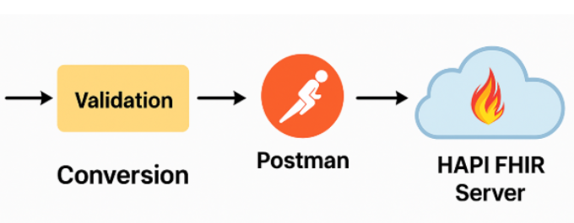
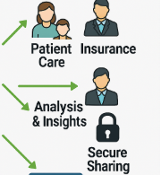
FHIR-Based Prediction of Hospital Readmission for Patients Aged 50 Plus
Presented by
Oscar Odera
&
Frank Ofosu

Slide 2
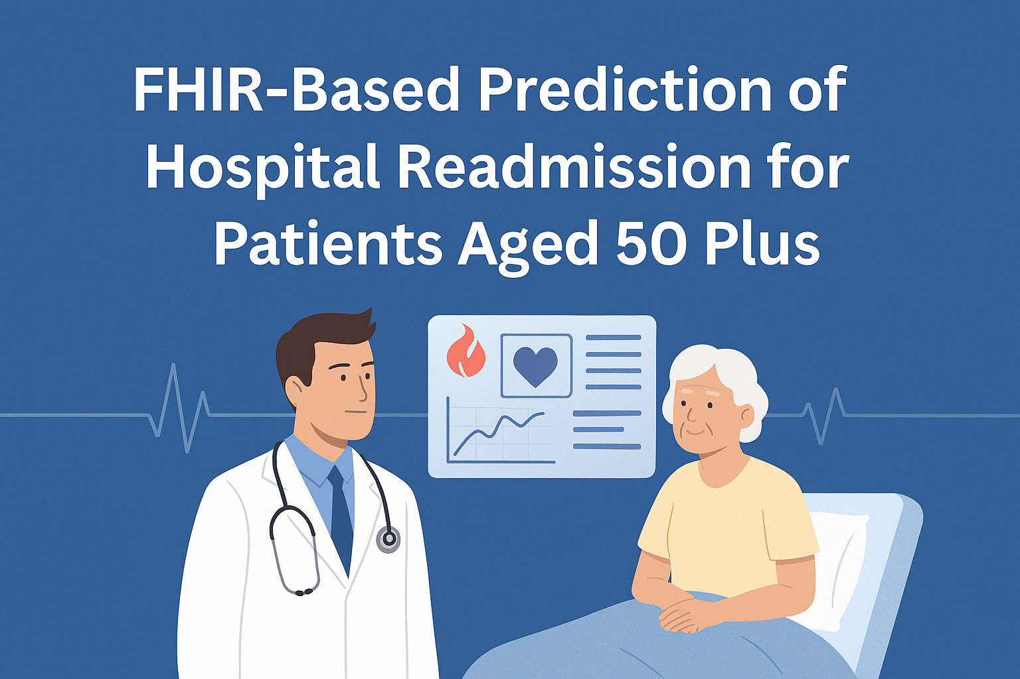
Introduction
Welcome to our presentation on an innovative AI in Healthcare research project focused on predicting hospital readmissions in older adults. This work represents a collaborative effort to improve patient outcomes while reducing healthcare costs through predictive analytics. Our Project demonstrates how Fast Healthcare Interoperability Resources (FHIR) data can be leveraged with machine learning to identify patients at risk of readmission within the critical 30-day window.
AI Solution
Our project harnesses artificial intelligence to predict readmission risk by analyzing structured clinical and encounter data from FHIR JSON files, enabling targeted interventions for high-risk patients before complications arise.

Slide 3

Literature Review
Traditional Models
Early risk prediction utilized the LACE index (Length of stay, Acuity, Comorbidities, ED visits) and HOSPITAL score, achieving moderate predictive power with AUCs of 0.60-0.70.
Statistical Approaches
Logistic regression models incorporating demographics, diagnoses, and basic lab values demonstrated improved performance, with AUCs reaching 0.75 in condition-specific implementations.
Advanced AI Methods
Recent studies like Michailidis et obtained an area under the curve (AUC) of 0.78 by utilizing a Random Forest classifier with administrative, clinical-medical, and operational data.
Current Research Gaps
Contemporary literature emphasizes the need for models balancing predictive accuracy with clinical interpretability, particularly for implementation in clinical decision support systems.

Slide 4



Problem Statement
Patient Impact
High readmission rates negatively affect patient outcomes, causing disruption to recovery and increasing risk of hospital-acquired complications
Financial Burden
Hospitals face significant financial penalties under value-based care models, with Medicare reducing payments by up to 3% for excessive readmissions
Tool Limitations
Current prediction models lack integration with granular EHR data and fail to effectively account for complex comorbidity interactions
Our research addresses the critical need for a data-driven, AI-based solution that can identify at-risk patients early in their care journey, enabling timely intervention before discharge. By leveraging the rich data structure of FHIR resources, we have to created a more accurate and clinically useful prediction model.

Slide 5





Justification of Population Chosen
Care Complexity
These patients typically require more intensive post-discharge care coordination and monitoring.
High-Risk Conditions
Our focus population includes patients aged 50+ with major chronic conditions including heart failure, COPD, and diabetes mellitus.
Multiple specialists involved
Social determinants often significant
Data Richness
Higher baseline readmission rates (25-30%)
3
FHIR data structure allows detailed tracking of clinical parameters critical for this population.
Complex medication regimens
Significant care transition challenges
Longitudinal lab value trends
Medication reconciliation data
Encounter frequency patterns

Slide 6
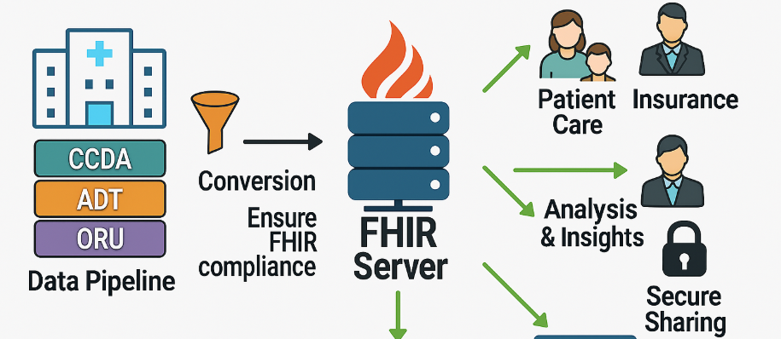




FHIR Data Pre-processing Workflow
FHIR Conversion
Validation
Aggregation
Data Extraction
Transform extracted data into standardized FHIR resources using mapping templates and validation algorithms
Validate converted FHIR resources on HAPI-FHIR server to ensure compliance with specification standards
Compile validated FHIR resources into comprehensive patient-level datasets ready for machine learning processing
Extract clinical data from legacy formats FHIR JSON (ORU, CCDA, ADT) containing vital signs, lab results, diagnoses, and encounter information

Slide 7
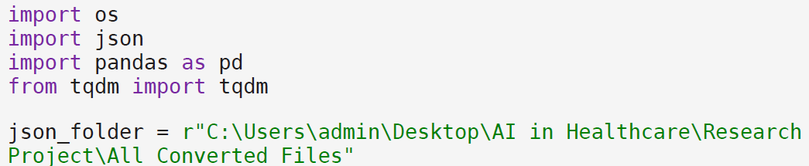
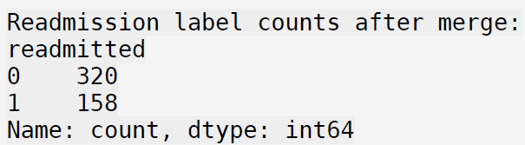
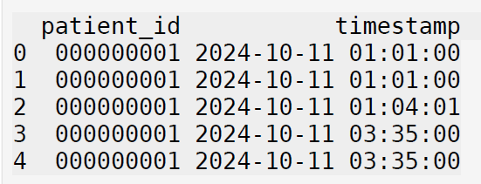
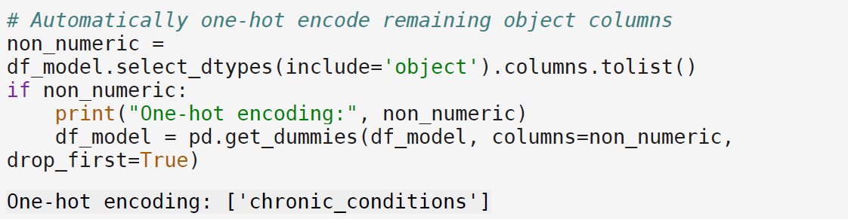
Code Demo: Data Preparation
Data Loading and Parsing
Feature Engineering
Outcome Labeling
Our process began with loading an initial dataset containing basic patient demographic information. We then parsed over 2,000 FHIR JSON files to extract timestamps that are very crucial in determining the 30 day readmission prediction.
We engineered critical features including condition counts, comorbidity indices, and laboratory value statistics. Time-based features such as length of stay and previous hospitalizations were calculated from encounter resources.
Patients were labeled as "readmitted" if our algorithm detected a follow-up inpatient encounter within 30 days of discharge. This required careful temporal analysis of the Encounter resources in the FHIR dataset.
Created 15+ derived features from raw FHIR data
Identified index hospitalizations
Applied statistical transformations to lab values
Applied 30-day readmission window

Slide 8
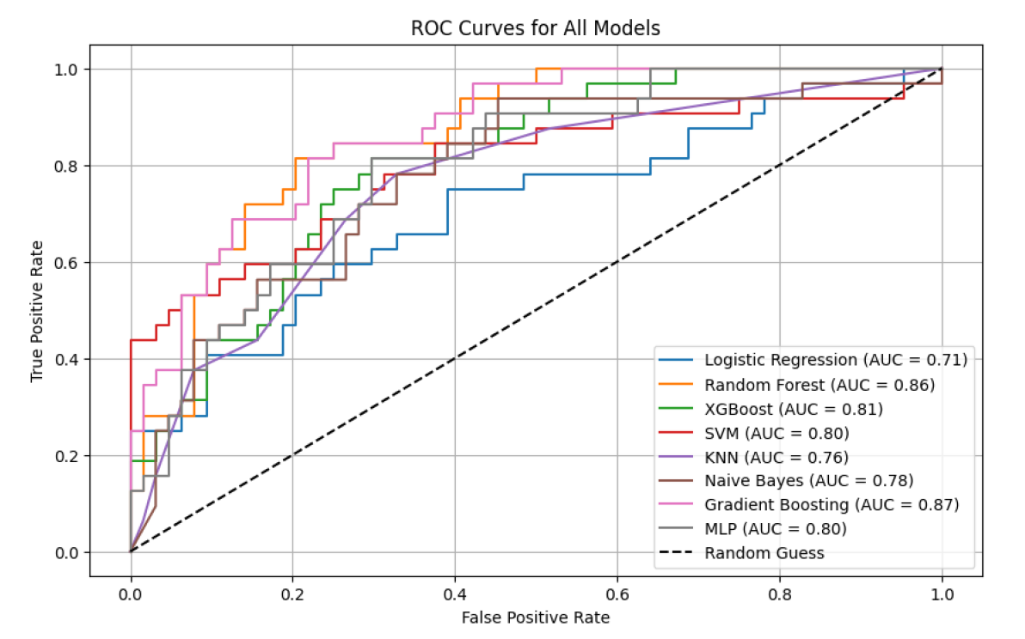
Code Demo: Model Analysis
We implemented and compared multiple machine learning approaches, with particular attention to model performance across different evaluation metrics. Model training involved stratified cross-validation to account for class imbalance, as readmissions represented approximately 18% of our dataset. Hyperparameter optimization was conducted via GridSearchCV, with particular focus on the trade-off between precision and recall.

Slide 9
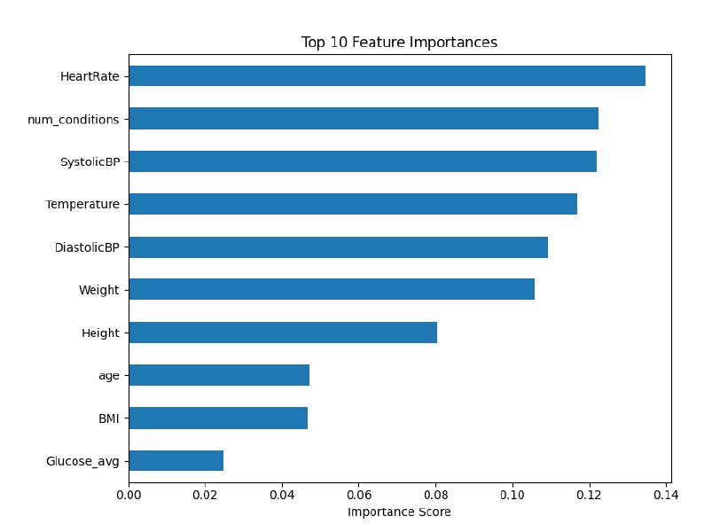
Relevance and Impact on Target Population
Our prediction model enables clinicians to identify high-risk elderly patients before discharge, they do this by keenly observing the feature that are critical in determining readmission as shown in this figure.
For patients with complex chronic conditions, this translates to more thorough discharge preparation, tailored follow-up scheduling, and appropriate home care arrangements.
The framework we've developed can be integrated into hospital EHR systems, providing real-time risk assessment as part of the clinical workflow. This practical implementation path significantly enhances the translational value of our research.

Slide 10
Logic of Findings
10
87%
83%
Key Predictors
AUC Score
Recall Rate
Top features with highest feature importance in final model
Best performing model (Gradient Boosting)
Percentage of actual readmissions correctly identified
Our analysis revealed that laboratory values, particularly trends in heart rate, creatinine, number of conditions, systolicBP, were among the strongest predictors of readmission risk. The presence and severity of chronic diseases, especially when multiple conditions coexisted, significantly increased readmission probability.
Ensemble machine learning models consistently outperformed linear approaches, confirming our hypothesis that complex interactions between clinical variables are crucial in readmission prediction. This aligns with the clinical reality that patient risk factors often interact in non-linear ways.
For model evaluation, we found that Area Under the Curve (AUC) and recall were the most clinically relevant metrics, as they best capture a model's ability to identify patients who genuinely need intervention, which is the primary use case in a clinical setting.

Slide 11
References
Forecasting Hospital Readmissions with Machine Learning. PMC Home, pmc.ncbi.nlm.nih.gov/articles/PMC9222500/.
Prediction of Unplanned Hospital Readmission Using Clinical and Longitudinal Wearable Sensor Features." PMC Home, pmc.ncbi.nlm.nih.gov/articles/PMC10120790/.
An Analysis of the Effectiveness of a Commercial Hospital Artificial Intelligence System in Reducing Readmissions in High-risk Medicare Patients. Welcome to RUcore - Rutgers University Community Repository, rucore.libraries.rutgers.edu/rutgers-lib/66958/.
ClinicalBERT: Modeling Clinical Notes and Predicting Hospital Readmission." ArXiv.org, arxiv.org/abs/1904.05342.
Predicting Hospital Readmission Via Cost-Sensitive Deep Learning. IEEE Xplore, ieeexplore.ieee.org/document/8338085.
Effective Hospital Readmission Prediction Models Using Machine-learned Features. BioMed Central, 24 Nov. 2022, bmchealthservres.biomedcentral.com/articles/10.1186/s12913-022-08748-y.

